Slide 1
CSUF 2018 Basketball Stats
By: Joshua Ungheanu, Cameron Mcphie, Andrew Shaker

Slide 2
Our web application…
Cal State University Basketball Statistic Web Application that contains data about each player, team and game.
Gives general viewers access to view the data only.
Staff logged in – have access to view the data and make any changes:
Add
Edit
Update
View who modified the data.
Only information on the database that the admin gives permission to modify.
MySQL admin have complete access to modifying the database and any information.

Slide 3
USE CASE QUESTIONS
How do I log in?
How do I reset my password?
How do I add game stats?
How do I activate or inactivate a player?
How do I add a player?
How do I view the schedule?
How do I see a box score of a game?
How do I view a plater stats per game?
How do I view the team roster?

Slide 4
USE CASE

Slide 5
ERD VIEW

Slide 6
DEPLOYMENT VIEW

Slide 7
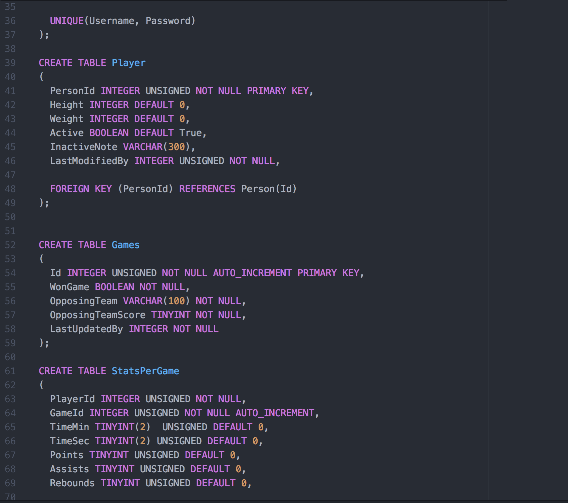
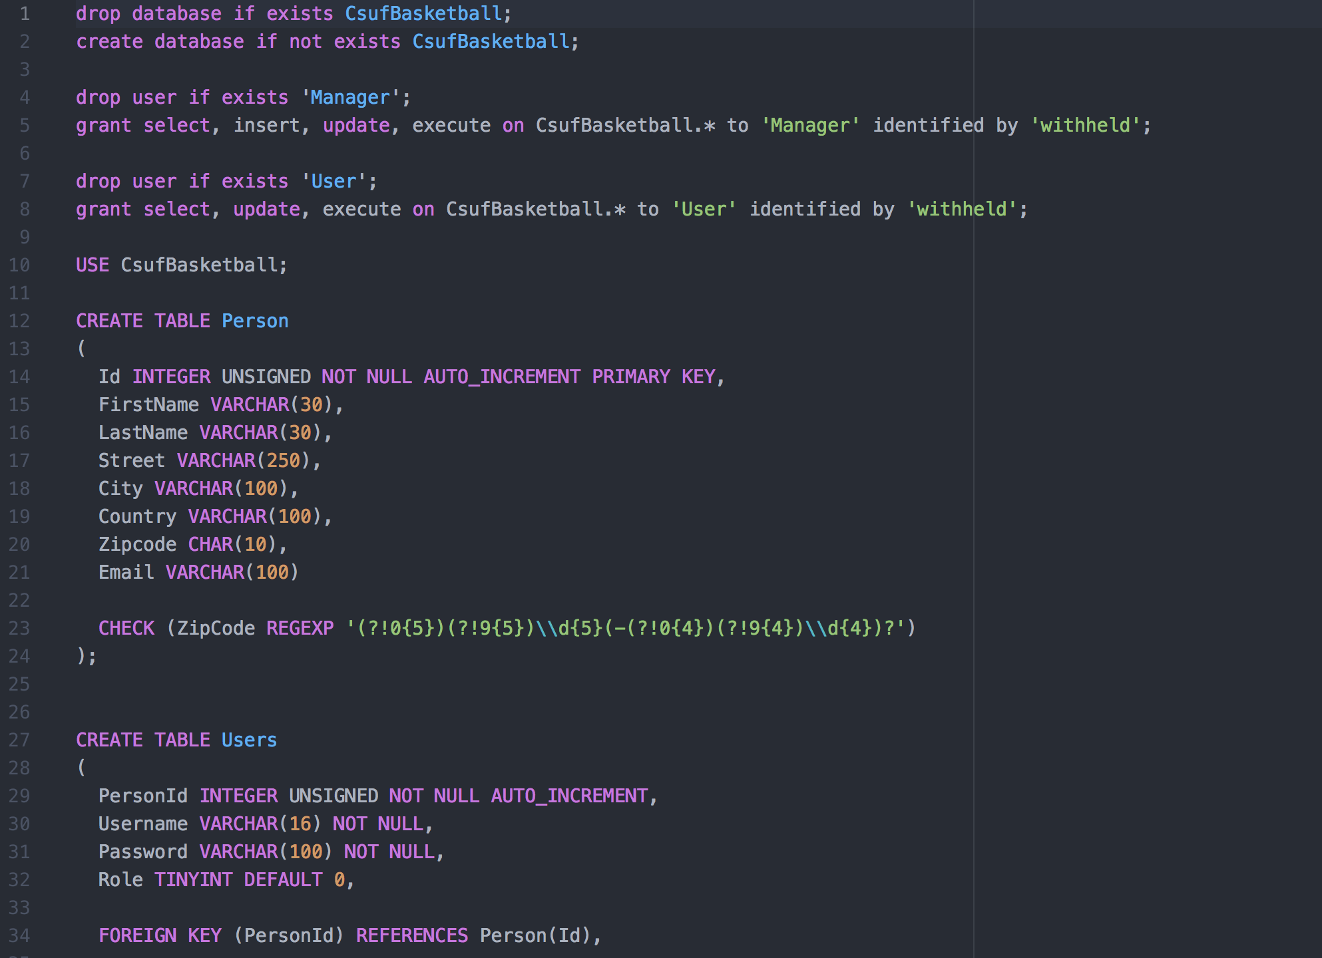
IMPLEMENTATION VIEW

Slide 8
REQUIREMENT VIEW
READERS:
Readers shall be able to view players statistic data.
Readers shall be able to view current games and upcoming games.
Readers shall be able to view each team and their statistics (games won, loss, and played).
Readers shall be able to view if players are active or inactive on certain games.
Readers shall not change any stats or crucial data for any player or game.
Readers shall not access any database or have control of any information.
DATA:
Data shall be able to change as the users update the players.
Data shall be able to change as the admin changes the database.
ADMIN:
Admin shall be able to view players statistic data.
Admin shall be able to view current games and upcoming games.
Admin shall be able to view each team and their statistics.
Admin shall be able to view if players are active or inactive.
Admin shall be able to modify any data on the database.
Admin shall be able to remove any user off the database.
Admin shall be able to modify any tables in the database.

Slide 9
REQUIREMENT VIEW DIAGRAM

Slide 10
CONFIGURATION MANAGEMENT VIEW
Configuration Management
Slack – Communication for when we are unable to meet and work together
Git & GitHub – Used to control documentation source and source code
Lucid Chart – Used for creating views
Atom – Text Editor used for writing code (Integrates with Github)
Apache – Web Server
MySQL – Relation Database Server
Linux(Ubuntu 16.04) – OS for running servers

Slide 11
C.I.A. Confidentiality Integrity Availability
Confidentiality is the avoidance of the unauthorized disclosure of information.
Access control
Authentication
Integrity: the property that information has not be altered in an unauthorized way.
Backups:
Data correcting codes
Availability: the property that information is accessible and modifiable in a timely fashion by those authorized to do so.

Slide 12
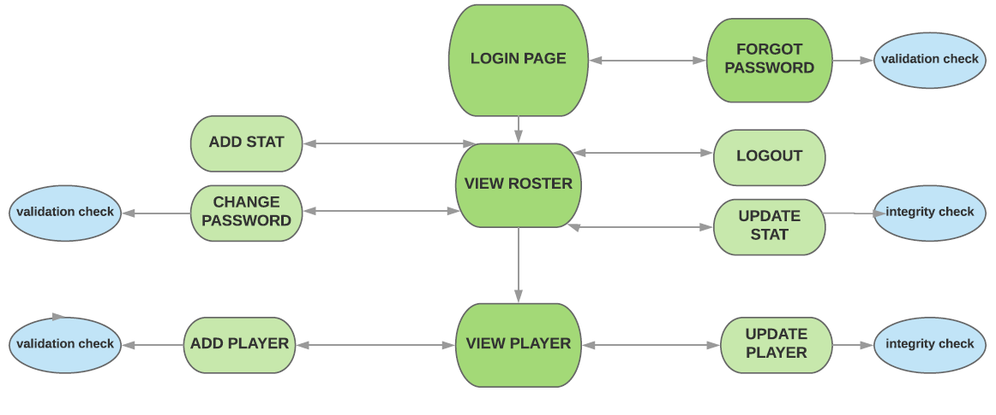
SECURITY DIAGRAM

Slide 13
SECURITY FEATURES
Our system will have the following security features:
Multi factor authentication only applies to forgotten credentials
Database encryption
Validation checks
Integrity checks
User privilege and access control ensuring availability and integrity and producing confidentiality

Slide 14
The End
Thank you!

